Slide 1

Driver Drowsiness Detection System
Using Data Science, Machine Learning and
Artificial Intelligence
Presented By :
Anuragini.B (Btech.IT)

Slide 2
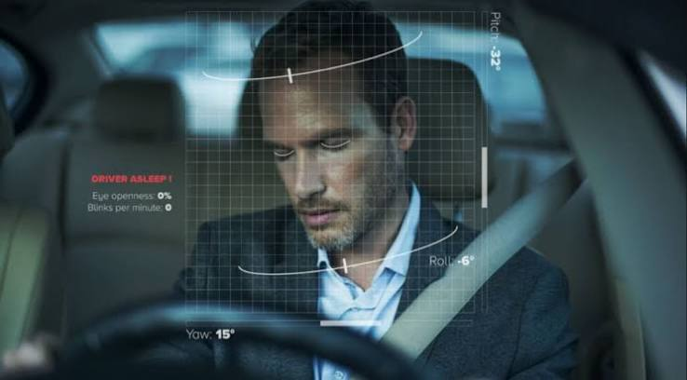


Introduction
Nowadays, road accidents caused by driver fatigue are increasing. When a driver feels sleepy, their concentration and reaction time decrease, which can lead to serious accidents. This project aims to detect drowsiness in real time using a webcam and alert the driver before an accident occurs.

Slide 3
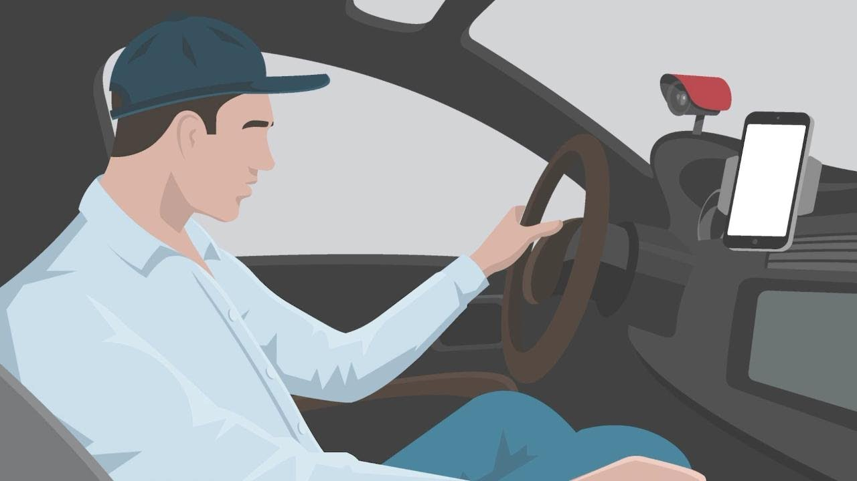
Problem Statement
Many accidents happen because drivers continue driving even when they are tired. It is difficult to identify drowsiness manually while driving. Therefore, we developed a smart system that continuously monitors the driver's eyes and gives an alert if signs of drowsiness are detected.

Slide 4
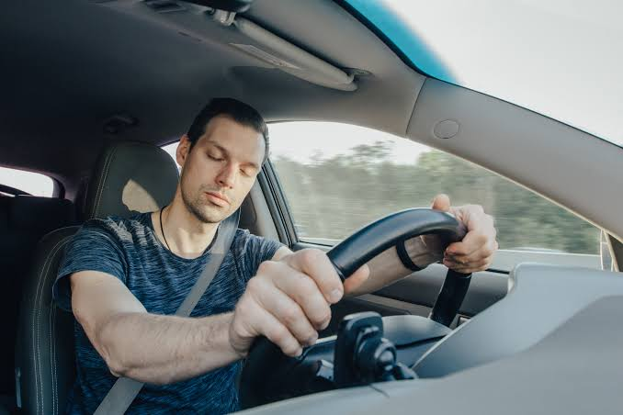

Objectives
To detect driver drowsiness in real time.
To monitor eye movements using a webcam.
To provide an instant warning when the driver feels sleepy.
To improve road safety and reduce accidents

Slide 5

Technologies Used
Programming Language
Python
Libraries
OpenCV
Media Pipe
NumPy
Pandas
Scikit-learn
Hardware
Laptop/Desktop
Webcam

Slide 6

Data Science
In this project, Data Science is used to collect and analyze data related to driver behavior. The dataset contains images of drivers with open and closed eyes. The data is cleaned, organized, and analyzed before training the model.

Slide 7

Machine Learning
Machine Learning is used to identify whether the driver is awake or drowsy. The model learns from the training data and predicts the driver's condition based on eye movements and eye closure.

Slide 8

Artificial Intelligence
Artificial Intelligence helps the system make decisions in real time. The webcam continuously captures the driver's face, detects the eyes, and checks whether they remain closed for a certain period. If drowsiness is detected, the system immediately activates an alarm.

Slide 9
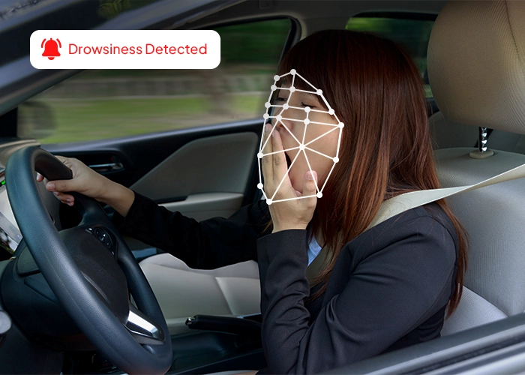
Working Process
Start the webcam
Detect the driver's face
Detect both eyes
Measure eye closure
Check whether the driver is awake or drowsy
If drowsiness is detected, an alarm is played

Slide 10
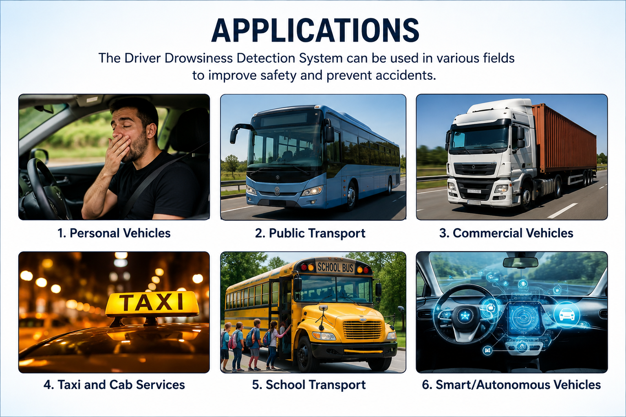
Applications
Cars
Buses
Trucks
Taxi services
Public transport
Smart vehicles

Slide 11

Conclusion
This project demonstrates how Data Science, Machine Learning, and Artificial Intelligence can work together to improve road safety.
The system is simple, effective, and capable of detecting driver drowsiness in real time, helping reduce accidents caused by fatigue.

Slide 12
Thank You

